Slide 1
Problem Statement Worksheet (Hypothesis Formation)
How should Big Mountain Resort select their facilities price in the market segment what it deserves based on the quality of their facilities?
H
1
Context
4
Constraints within solution space
Big Mountain Resort is a ski resort located in Montana. Big Mountain is not capitalizing on its facilities as much as it could. Basing their pricing on just the market average does not provide the business with a good sense of how important some facilities are compared to others. The business wants some guidance base on the data of 330 resorts in the US.
Selecting a price that is not compatible with the market price.
The quality of the data that is from 330 resorts.
2
Criteria for success
5
Stakeholders to provide key insight
The increase in the business income.
More customers prefer to visit there.
Management
3
Scope of solution space
6
Key data sources
The business might loose high big of customers due to high price and the quality of facilities.
CVS file that has data about 330 resorts in US.
H
D
E
I
P
Notes:
Hypothesis: Create a Hypothesis with an emphasis on SMART principles. (S – Specific, M – Measurable, A – Achievable, R – Realistic, T – Timebound). If you cannot do this, you do not have a good grasp on the business problem.
Context: With context, we have clearly identified the problem at hand and have elucidated on how our initiative may solve this problem, alongside the commercial implications this will have on the business.
Criteria for Success: Clearly defining the criteria for success ensures that the scope of your work is clearly defined and understood. Otherwise, if this isn’t defined – your work will never end which will result in mismatched expectations.
Scope of Solution Space: Scoping out the solution space ensures that the business initiative is SPECIFIC for a certain segment or area. This prevents solutions that have been developed being scaled and applied for all other business units that the solution may not be responsible or scalable for.
Constraints within Solution Space: Looking forward, what are the foreseeable problems we are likely to encounter? Could this be stakeholder resistance? Could this be we don’t have access to the right data?
Stakeholders to provide key insight: Who are the people I need to speak to, to get the answers I need for my data analysis?
What key data sources are required?
Based off my discussions with the key stakeholders – can we clearly list out all the data sources we need so we can make a highly targeted request as opposed to a scatter-gun approach where we ask for a bit of everything?

Slide 2
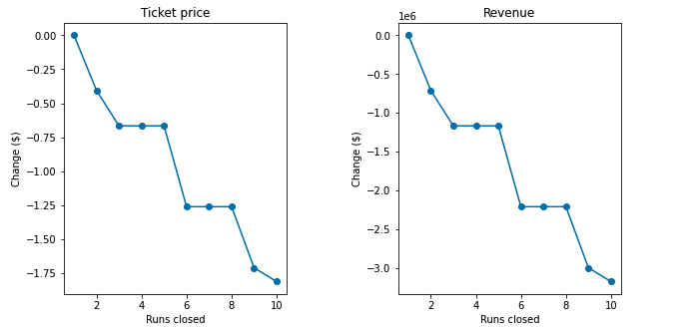
Recommendation and key findings
There are three scenario we can discuss
Scenario 1
This model says closing one run makes no difference. Closing 2 or 3 successively reduces support for ticket price and revenue.

Slide 3
Senario 2
In this scenario, Big Mountain is adding a run, increasing the vertical drop by 150 feet, and installing and additional chair lift.
But this scenario increases support for ticket price by $1.99
Over the season, this could be expected to amount $3,474,638
Scenario 3
In this scenario, you are repeating the previous one but adding 2 acres of snow making.
This scenario increases support for ticket price by $1.99 by the end of the season it will not affect total income.

Slide 4
Scenario 4
In this scenario, increasing the longest run by 0.2 miles and guaranteeing its snow coverage by adding 4 acres of snow making capability.
No difference whatsoever. Although the longest run feature was used in the linear model, the random forest model (the one we chose because of its better performance) only has longest run way down in the feature importance list.
Big Mountain currently charges $81 for each adult over the weekend. Based on the model, Big Mountain Resort’s modeled price is $95.87. The ticket price was suggested by the model that shows the quality of Big Mountain’s facilities in the marketplace.

